Slide 1
E-COMMERCE INTERNATIONALLY

Slide 2
OVERVIEW
01
01
Key Features and Modules
Description
01
01
01
Requirements
Team Members
02
01
Approach / Model
Diagrams
01
01
Architecture
01
Demo

Slide 3

DESCRIPTION
Our project is an e-commerce platform builder that helps small and medium-sized businesses create and manage their online stores. With a user-friendly store builder, AI-driven design assistance, multilingual support, and secure payment and shipping integrations, it enables businesses to establish an online presence and expand their reach locally and internationally.

Slide 4





PROJECT TIMELINE
Problem Identification
Requirement Specification
Design
Implemen-tation
Testing & Local deployment

Slide 5
REQUIREMENT ANALYSIS
Lack of Affordable Options
High Costs of Existing Platforms:
Small Businesses Rely on Social Media:
AI-Powered Assistance

Slide 6
LANGUAGES AND TOOLS
EXPRESS.JS
REACT-JS
SUPABASE
BACK-END
FRONT-END
DATABASE

Slide 7
TEAM MEMBERS

Slide 8



ALI AQDAS
BSSE NUST
COURSE: DATABASE SYSTEMS
FULL STACK DEVELOPER

Slide 9

DANISH SOHAIL
BSSE NUST
COURSE: DATABASE SYSTEMS
FRONT-END DEVELOPER

Slide 10
ARCHITECTURE
AGILE
WATERFALL
SOFTWARE
APPROACH
SCRUM
METHODOLOGY
XP-PROGRAMMING
SPIRAL

Slide 11

GIVES
Flexibility
AGILE
INCREMENTAL
COSTUMER
Delivery
METHODOLOGY
Feedback
BETTER
Teamwork

Slide 12
SYSTEM ARCHITECTURE MODEL
CLIENT
SERVER

Slide 13
SYSTEM ACRCHITECTURE DESIGN

Slide 14
CLIENT – SERVER
MVC

Slide 15
MODULES
OVERVIEW

Slide 16


User Registration and Authentication
Product Management
Order Management
Seller Analytics and Dashboard
Database Modules
Inventory Management

Slide 17
KEY FEATURES

Slide 18
FEATURING
AI

Slide 19









Data Analytics and Reporting
End-to-End Management
Provides real-time insights into sales, customer behavior, and store performance
Offers solutions for front-end store creation, back-end inventory management, and seamless order processing
Support for Local Brands in Pakistan
Cost-Effective Solutions
KEY FEATURES
Offers affordable pricing plans to make e-commerce accessible to small and medium-sized enterprises (SMEs).
Encourages and empowers local businesses to establish their online presence.
Customizable Templates
Scalable for Growth
A library of pre-designed templates optimized for various industries and markets.
AI-Powered Website Builder
Designed to support businesses as they grow, with features that scale up for larger inventories and higher customer traffic.

Slide 20
USERS
ADMIN (FUTURE)
STORE OWNER
CUSTOMER

Slide 21
REQUIREMENTS

Slide 22
FUNCTIONAL REQUIREMENTS
User Management
Store Management
Order + Product Management
The user can register himself and his credentials can be authenticated
The Store owner can make and manage his store
The User can order and owner can manage his products
Shopping Experience
AI Usage
Analytics Reporting
The user can have a full shopping experience, adding products to carts and ordering
The Store owner can use AI to build his store
The Owner can see his dashboard which has all his store info and analytics

Slide 23
NON-FUNCTIONAL REQUIREMENTS
SAFETY
SCALABILITY
Ensure the product doesn't cause harm, loss, or damage during use.
Support growing user bases and increasing traffic.
PERFORMANCE
SECURITY
The site must be fully loaded and functional within 1.5 seconds
Protection of user data and access control mechanisms

Slide 24
DIAGRAMS

Slide 25
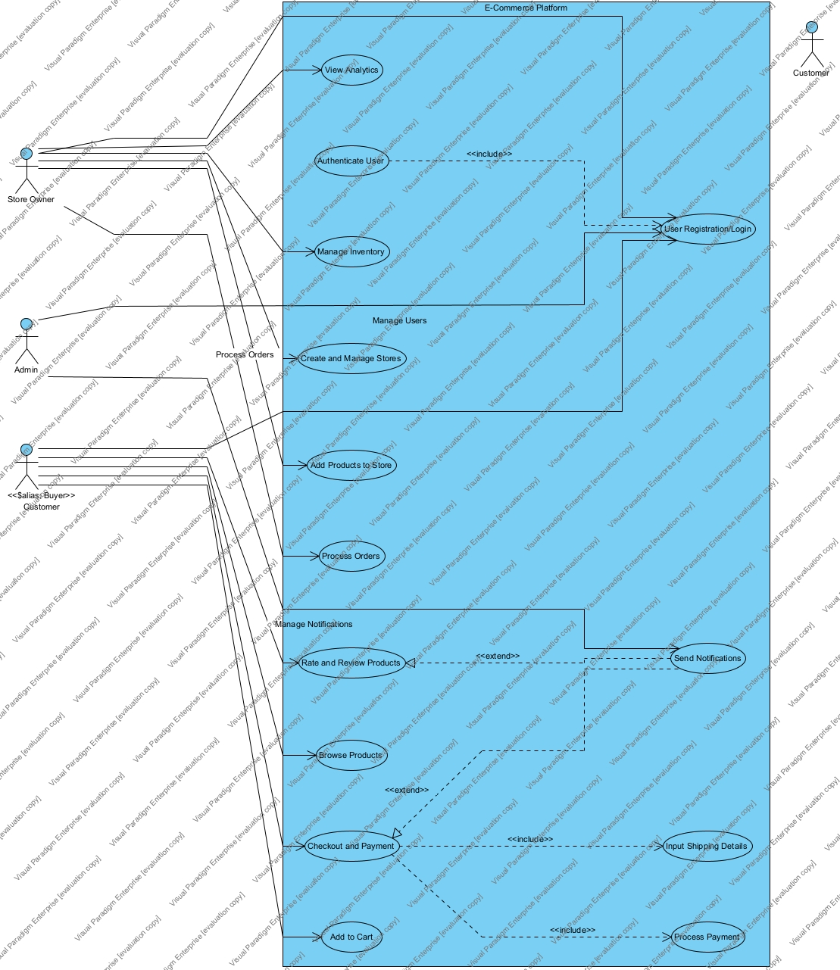
USE CASE

Slide 26
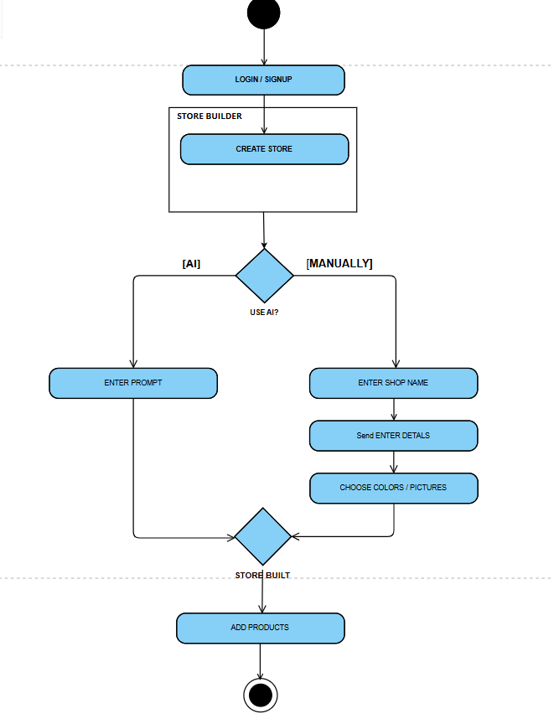
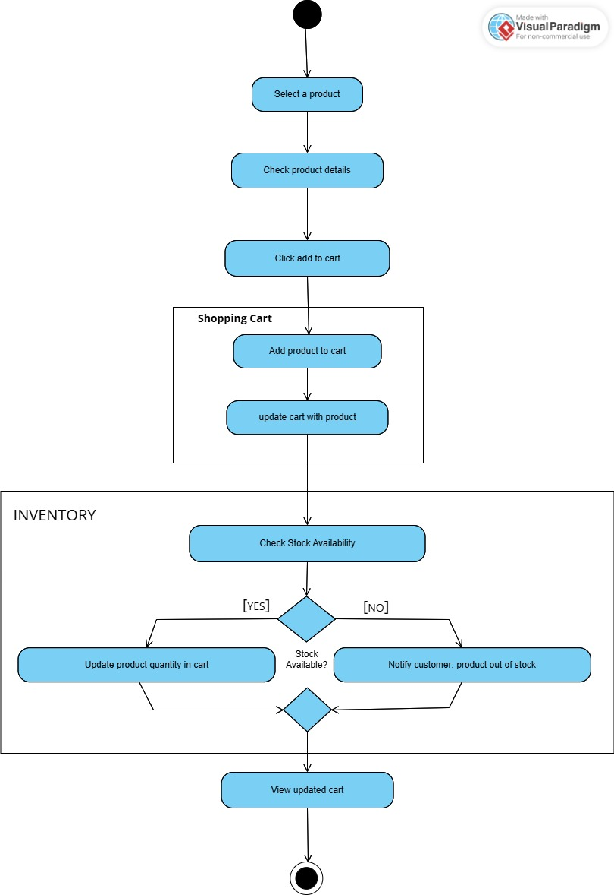
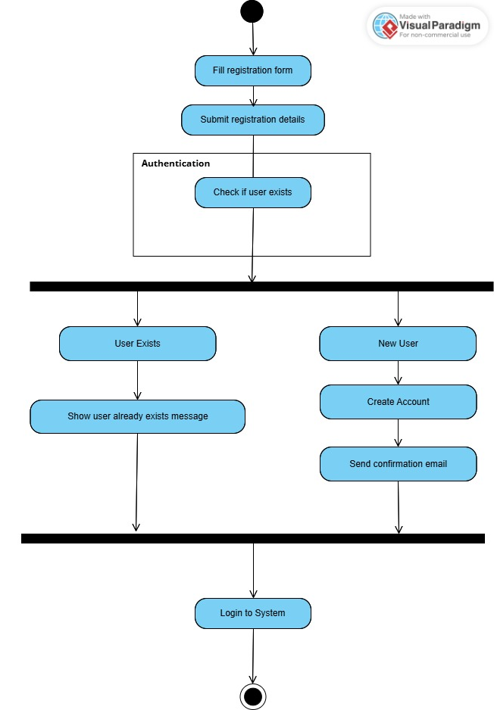
ACTIVITY DIAGRAM

Slide 27
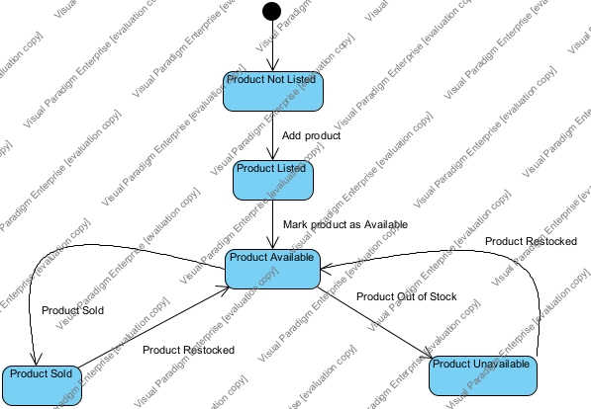
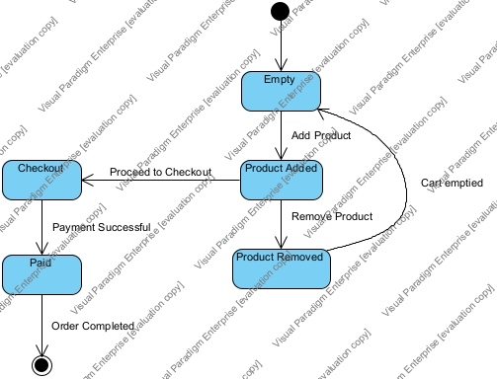
STATE DIAGRAM

Slide 28
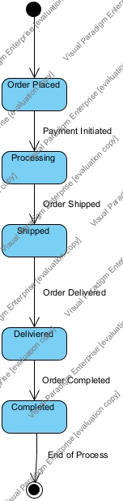
OVERALL FLOW

Slide 29
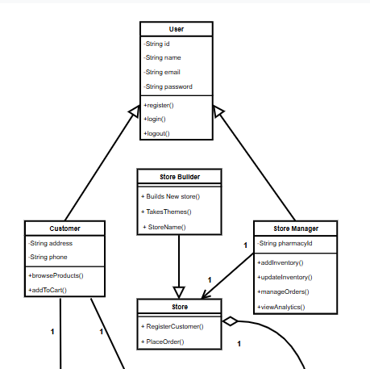
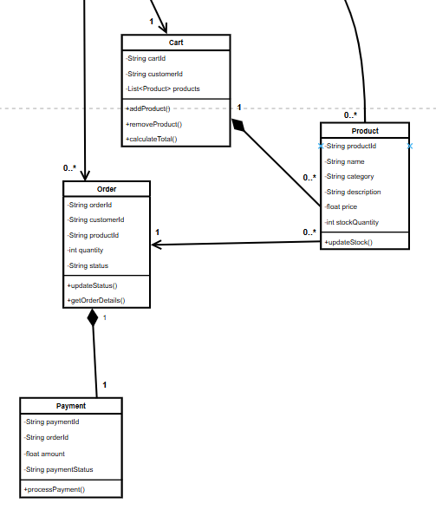
CLASS DIAGRAM

Slide 30
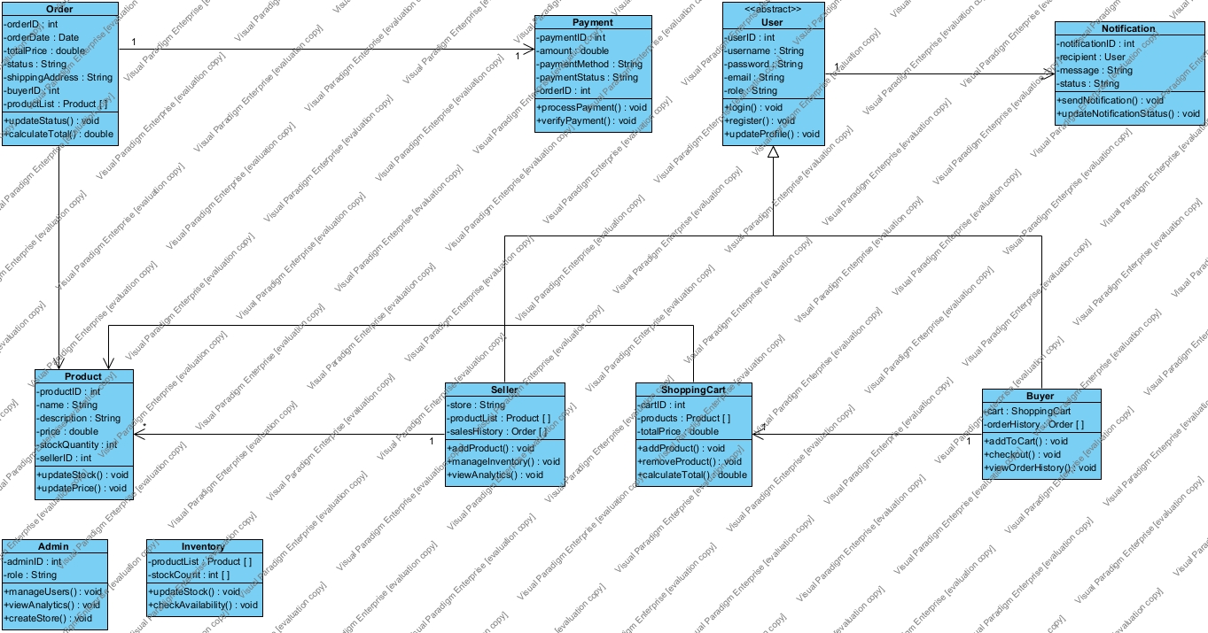

Slide 31
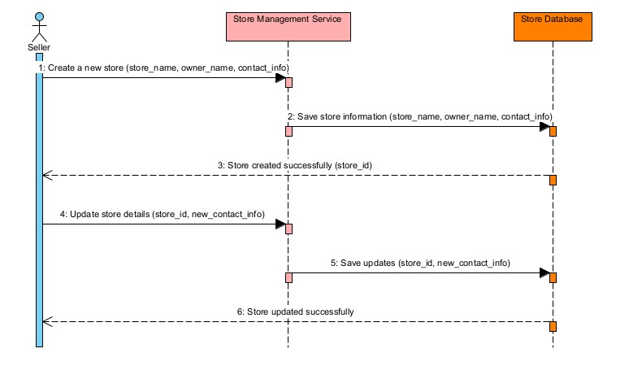
SEQUENCE DIAGRAM
STORE BUILDER

Slide 32
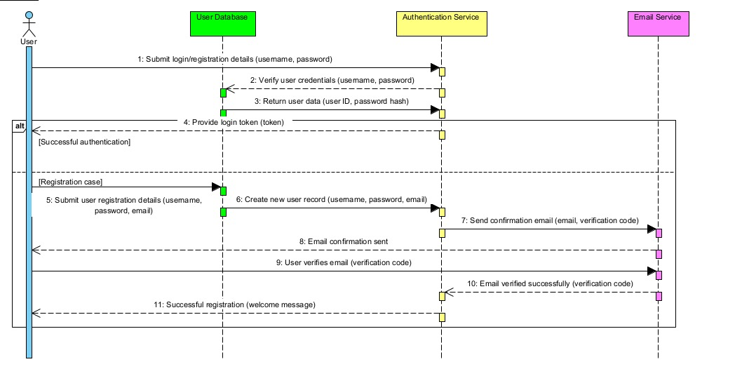
CUSTOMER

Slide 33
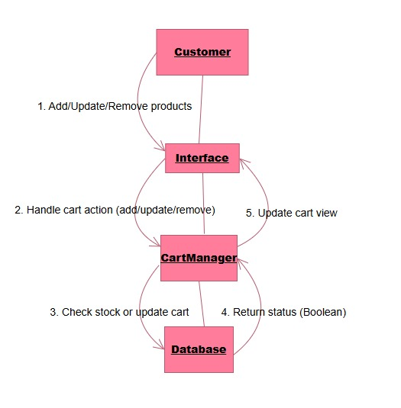
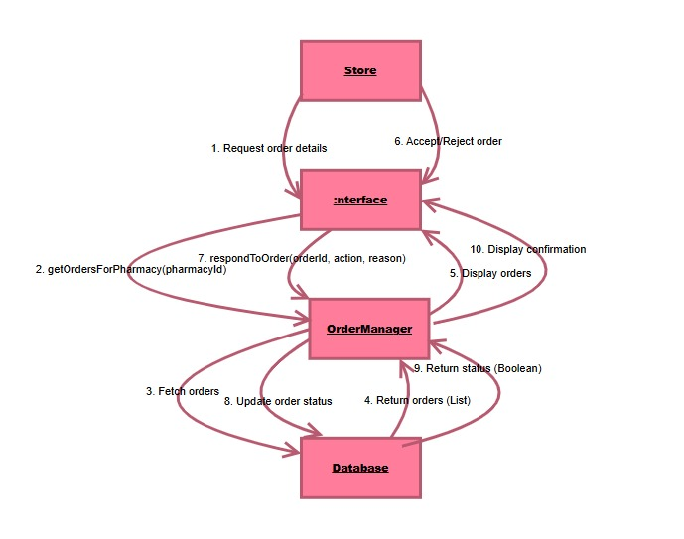
COMMUNICATION DIAGRAM

Slide 34
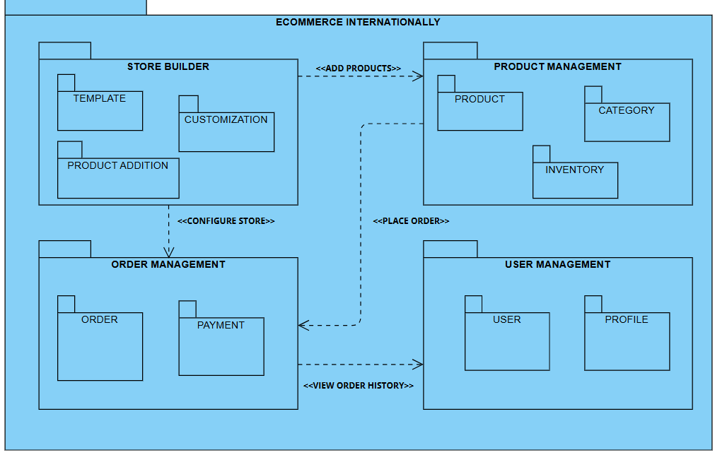
PACKAGE DIAGRAM

Slide 35
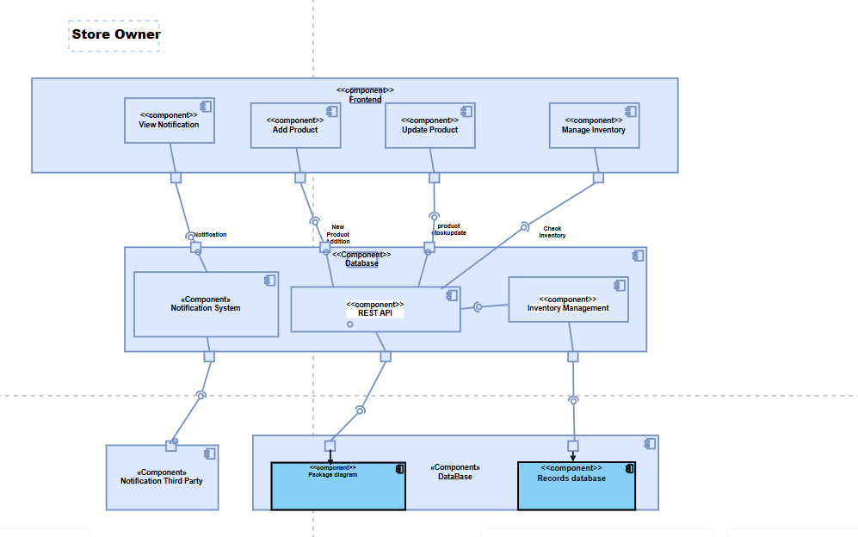
COMPONENT DIAGRAM

Slide 36
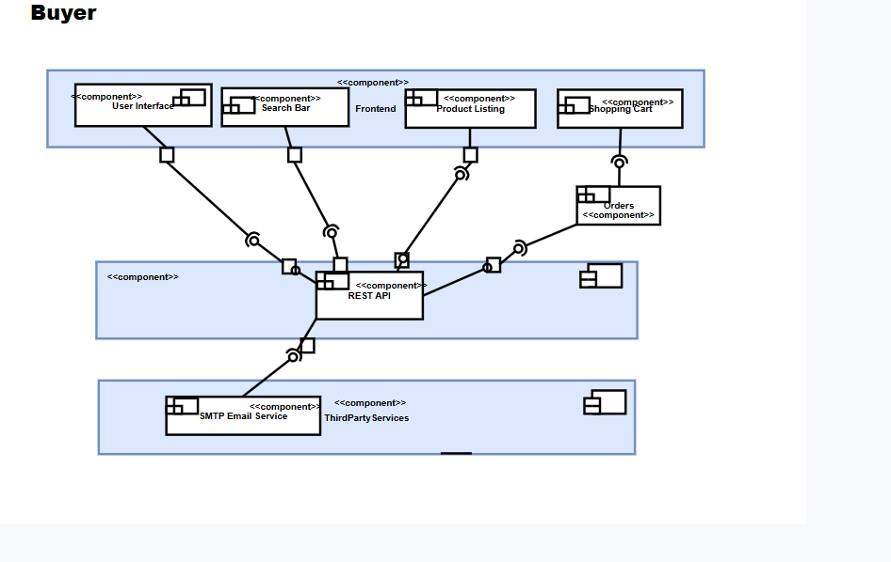
COMPONENT DIAGRAM

Slide 37
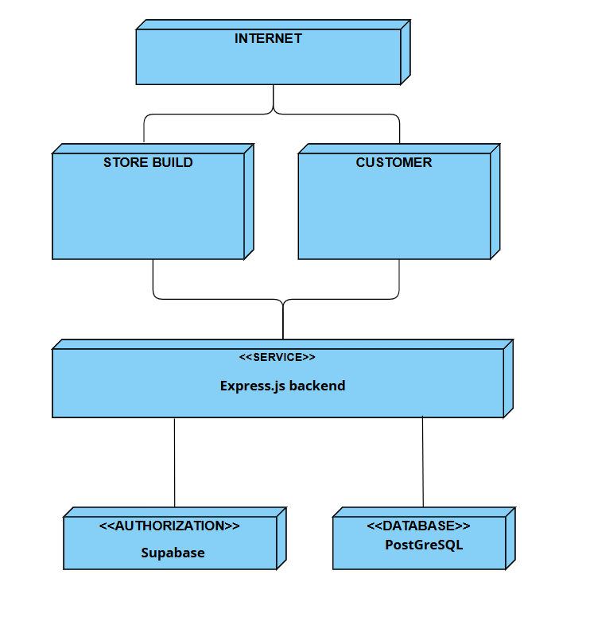
DEPLOYMENT DIAGRAM

Slide 38

THANK YOU

